Slide 1






.
Qt in Education
Widgets
and
Layouts
Notes:
The lecture is on widgets and layouts. The idea is to introduce the concepts of widgets and layouts and show how they fit together when creating designs.
Recommended reading before the lecture:
http://doc.trolltech.com/4.6/widgets-and-layouts.html and onwards (follow the link labelled “Next:” at the bottom of each page)

Slide 2


© 2011 Nokia Corporation and its Subsidiary(-ies).
The enclosed Qt Materials are provided under the Creative Commons
Attribution-Share Alike 2.5 License Agreement.
The full license text is available here:
http://creativecommons.org/licenses/by-sa/2.5/legalcode.
Nokia, Qt and the Nokia and Qt logos are the registered trademarks
of Nokia Corporation in Finland and other countries worldwide.

Slide 3

User Interface Components
User interfaces are built from individual widgets
46 widgets in Designer
59+ direct descendants from QWidget
QLabel
QScrollBar
QLineEdit
QPushButton
QDoubleSpinBox
Notes:
There are many widgets in Qt, and you can add even more.
59+ descendants from QWidget means that there are more than 59 widgets. For instance QAbstractButton inherits QWidget and result in five different buttons (push, radio, check, toolbar and command).

Slide 4
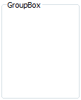
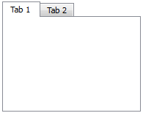
Widgets in Widgets
Widgets are placed in hierarchies
Container classes provide visual structure...
...but also functional (e.g. QRadioButton)
QGroupBox
QTabWidget
Notes:
Just placing widgets randomly does not help the user much. To structure the interface, a number of container widgets are available.
They provide a visual structure, as well as a functional structure. For instance, radio buttons are mutually exclusive within their specific container.

Slide 5
Traits of a Widget
Occupies a rectangular area of the screen
Receives events from input devices
Emits signals for “notable” changes
Are structured in a hierarchy
Can contain other widgets
Notes:
What is a widget?
A widget occupies a rectangular area of the screen. It sits there and waits for events (user input...)
It reacts to these events, and if anything notable happens (a text changes, an item is selected, a button is clicked) it emits a signal.
As said on the previous slide, they are structured in a hierarchy (parent-child) and can contain other widgets.

Slide 6

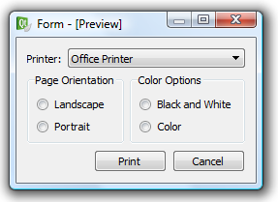
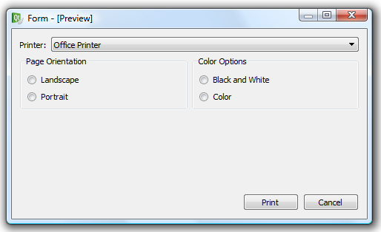
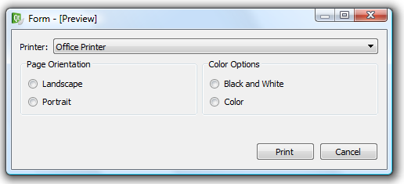
An Example Dialog
Widgets are placed in layouts – to make the user interface elastic
Notes:
An example dialog – letting the user pick a printer and decide some settings about the resulting output.
Widgets can be placed statically, but the Qt way is to place them in layouts. Layouts let the widgets stretch and move about to fill the available screen estate.
The interface becomes elastic

Slide 7
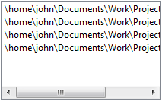
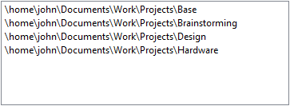



Why is Elastic Good?
Lets widgets adapt to contents
Lets widgets adapt to translations
Lets widgets adapt to user settings
Notes:
Why is elastic good?
For instance, contents, a list of long file names in a too narrow list box. Everything can be seen when it is stretched.
When translating the interface, short words such as “news” can become long, such as “nyheter” (Norwegian). Letting the buttons stretch avoids truncation of the contents.
When the user changes settings, such as font sizes, a elastic interface allows the widgets to respect this.

Slide 8



Layouts
There are several possible layouts available
Layouts and widgets “negotiate” for sizes and positions
Spacer springs can be used to fill voids
QHBoxLayout
QVBoxLayout
QGridLayout
Notes:
There are a number of available layouts.
The images show (left to right): vertical box, horizontal box and grid.
Layouts and widget negotiate for sizes and positions to determine the final size and location of each widget
To fill out voids (for instance, to push the buttons right in the previous slide) spacer springs can be used.

Slide 9
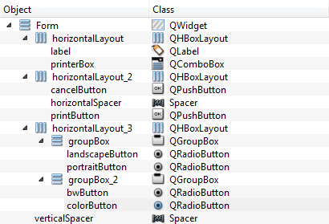
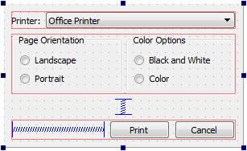
An Example Dialog
Dialogs are built from multiple layers of layouts and widgets
Note that layouts are not
parents of the widgets that
they manage.
Notes:
Returning to the example dialog, we can see how the hierarchy of widgets and the actual layout sticks together. (explain the images above)
The next slide will show the dialog as code.

Slide 10



An Example Dialog
QVBoxLayout *outerLayout = new QVBoxLayout(this);
QHBoxLayout *topLayout = new QHBoxLayout();
topLayout->addWidget(new QLabel("Printer:"));
topLayout->addWidget(c=new QComboBox());
outerLayout->addLayout(topLayout);
QHBoxLayout *groupLayout = new QHBoxLayout();
...
outerLayout->addLayout(groupLayout);
outerLayout->addSpacerItem(new QSpacerItem(...));
QHBoxLayout *buttonLayout = new QHBoxLayout();
buttonLayout->addSpacerItem(new QSpacerItem(...));
buttonLayout->addWidget(new QPushButton("Print"));
buttonLayout->addWidget(new QPushButton("Cancel"));
outerLayout->addLayout(buttonLayout);
Notes:
Implementing the dialog, we start with the top level layout. The dialog can be divided into rows, so we use a vertical box layout as the outer layout.
To that layout we add the sub-layouts and spaces as needed.
Continues

Slide 11
An Example Dialog
QVBoxLayout *outerLayout = new QVBoxLayout(this);
QHBoxLayout *topLayout = new QHBoxLayout();
topLayout->addWidget(new QLabel("Printer:"));
topLayout->addWidget(c=new QComboBox());
outerLayout->addLayout(topLayout);
QHBoxLayout *groupLayout = new QHBoxLayout();
...
outerLayout->addLayout(groupLayout);
outerLayout->addSpacerItem(new QSpacerItem(...));
QHBoxLayout *buttonLayout = new QHBoxLayout();
buttonLayout->addSpacerItem(new QSpacerItem(...));
buttonLayout->addWidget(new QPushButton("Print"));
buttonLayout->addWidget(new QPushButton("Cancel"));
outerLayout->addLayout(buttonLayout);
Notes:
The top row consists of a horizontal box layout with a label and a drop-down-list (a combo box).
Continues

Slide 12
An Example Dialog
QVBoxLayout *outerLayout = new QVBoxLayout(this);
QHBoxLayout *topLayout = new QHBoxLayout();
topLayout->addWidget(new QLabel("Printer:"));
topLayout->addWidget(c=new QComboBox());
outerLayout->addLayout(topLayout);
QHBoxLayout *groupLayout = new QHBoxLayout();
...
outerLayout->addLayout(groupLayout);
outerLayout->addSpacerItem(new QSpacerItem(...));
QHBoxLayout *buttonLayout = new QHBoxLayout();
buttonLayout->addSpacerItem(new QSpacerItem(...));
buttonLayout->addWidget(new QPushButton("Print"));
buttonLayout->addWidget(new QPushButton("Cancel"));
outerLayout->addLayout(buttonLayout);
Notes:
The second row is built from the group boxes. As they themselves contain sub-widgets, we will look at that code in detail a couple of slides on.
Continues

Slide 13
An Example Dialog
QVBoxLayout *outerLayout = new QVBoxLayout(this);
QHBoxLayout *topLayout = new QHBoxLayout();
topLayout->addWidget(new QLabel("Printer:"));
topLayout->addWidget(c=new QComboBox());
outerLayout->addLayout(topLayout);
QHBoxLayout *groupLayout = new QHBoxLayout();
...
outerLayout->addLayout(groupLayout);
outerLayout->addSpacerItem(new QSpacerItem(...));
QHBoxLayout *buttonLayout = new QHBoxLayout();
buttonLayout->addSpacerItem(new QSpacerItem(...));
buttonLayout->addWidget(new QPushButton("Print"));
buttonLayout->addWidget(new QPushButton("Cancel"));
outerLayout->addLayout(buttonLayout);
Notes:
Between the buttons and the top rows we add a spacer item. This prevents the entire dialog to stretch vertically. Instead we decide where to insert blank space if necessary.
Continues

Slide 14
An Example Dialog
QVBoxLayout *outerLayout = new QVBoxLayout(this);
QHBoxLayout *topLayout = new QHBoxLayout();
topLayout->addWidget(new QLabel("Printer:"));
topLayout->addWidget(c=new QComboBox());
outerLayout->addLayout(topLayout);
QHBoxLayout *groupLayout = new QHBoxLayout();
...
outerLayout->addLayout(groupLayout);
outerLayout->addSpacerItem(new QSpacerItem(...));
QHBoxLayout *buttonLayout = new QHBoxLayout();
buttonLayout->addSpacerItem(new QSpacerItem(...));
buttonLayout->addWidget(new QPushButton("Print"));
buttonLayout->addWidget(new QPushButton("Cancel"));
outerLayout->addLayout(buttonLayout);
Notes:
Finally, the bottom row consists of a spacer item and two buttons. Here we can really see why the spaces are represented by a spring symbol. It pushed the buttons to the right.
Continues

Slide 15


An Example Dialog
Horizontal box, contains group boxes, contains vertical boxes, contains radio buttons
QHBoxLayout *groupLayout = new QHBoxLayout();
QGroupBox *orientationGroup = new QGroupBox();
QVBoxLayout *orientationLayout = new QVBoxLayout(orientationGroup);
orientationLayout->addWidget(new QRadioButton("Landscape"));
orientationLayout->addWidget(new QRadioButton("Portrait"));
groupLayout->addWidget(orientationGroup);
QGroupBox *colorGroup = new QGroupBox();
QVBoxLayout *colorLayout = new QVBoxLayout(colorGroup);
colorLayout->addWidget(new QRadioButton("Black and White"));
colorLayout->addWidget(new QRadioButton("Color"));
groupLayout->addWidget(colorGroup);
Notes:
Returning back to the second row. The groupLayout is a horizontal box layout to which we add the two group boxes.
In each group box we create a vertical box layout to which we add the radio buttons.
As the radio buttons are in separate trees of the widget hierarchy, they are only mutually exclusive in each branch.

Slide 16
An Example Dialog
You can build the same structure using Designer
Notes:
In the designer tool (a part of QtCreator, we will look at it soon), we can see exactly the same structure.
Refer to the code at each level of the object hierarchy shown.

Slide 17

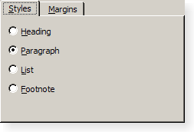
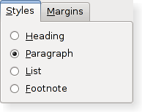
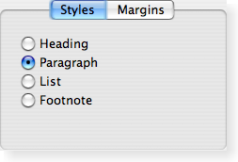
Cross Platform Styles
Widgets are drawn using a platform specific style to ensure a native look
Notes:
As Qt is a cross platform tool, all widgets are drawn with a native look using a style.
There are numerous styles – and for KDE there are even more. For KDE, styles are a part of the tweakability of the desktop itself.

Slide 18
Cross Platform Issues
Comparing user interfaces tells us that there is more to it than just changing the style of the widgets
  Form layout
  Dialog button ordering
  Standard dialogs
Notes:
When it comes to moving an application across platforms, styling is not all that it takes. There are many details to take into account when deploying on different desktops.
Qt tries to address as much as possible of this. For instance, one can hint at which type of dialog to use on Mac OS X where there are several types (e.g. sheets in Mac OS X).
Continues

Slide 19
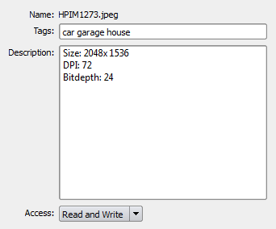
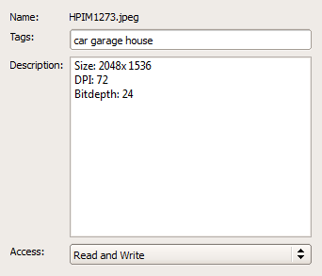
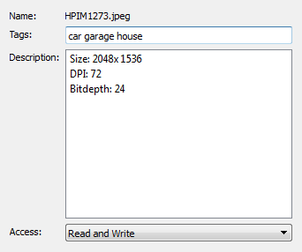
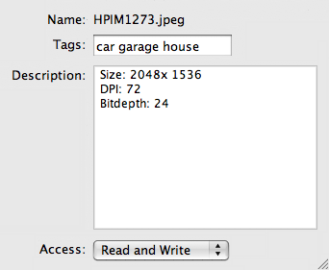
Cross Platform Issues
Comparing user interfaces tells us that there is more to it than just changing the style of the widgets
  Form layout
  Dialog button ordering
  Standard dialogs
Plastique
ClearLooks
Windows
MacOS X
Notes:
One example of attention to detail is the form layout. It is a special, two column, layout for property dialogs.
Show what differs between the platforms
- Alignment of labels (to the left)
- Size of drop down lists
Continues

Slide 20



Cross Platform Issues
Comparing user interfaces tells us that there is more to it than just changing the style of the widgets
  Form layout
  Dialog button ordering
  Standard dialogs
Notes:
Another, very important aspect is the ordering of buttons in dialog boxes.
Where does the “accept” end up? where is cancel? Where do I find help?
Imagine using an application where cancel and ok where mixed up...
Using the QDialogButtonBox widget, this is taken care of by Qt.
Continues

Slide 21
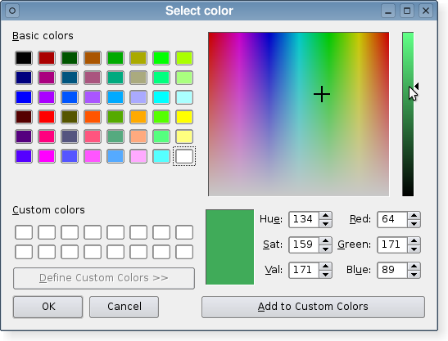
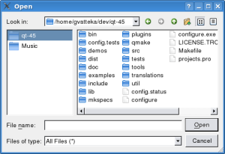
Cross Platform Issues
Comparing user interfaces tells us that there is more to it than just changing the style of the widgets
  Form layout
  Dialog button ordering
  Standard dialogs
Notes:
One final detail is the dialogs used for standardized tasks such as opening and saving files, printing, picking a color, etc.
Qt provides a range of standard dialogs that handle these tasks in a native manner.

Slide 22

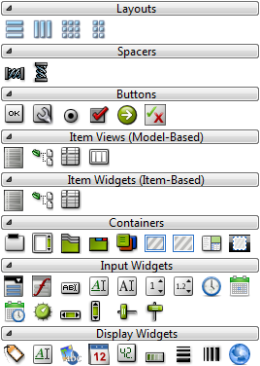
Common Widgets
Qt contains numerous widgets for all common situations.
Designer has a good overview of the widget groups
Notes:
There are many widgets in Qt, so one issue is to be able to pick the right one for the right task.
Designer (a part of QtCreator) has a nice grouped list of some of the available widgets.
Continues, looking through some of each group

Slide 23
Common Widgets
Buttons
All buttons inherit the
QAbstractButton base class.
Signals
  clicked() - emitted when the button is clicked (button released).
  toggled(bool) – emitted when the check state of the button is changed.
Properties
  checkable – true if the button can be checked. Makes a push button toggle.
  checked – true when the button is checked.
  text – the text of the button.
  icon – an icon on the button (can be displayed together with text).
QAbstractButton
QPushButton
QCheckBox
QRadioButton
Notes:
Buttons are one of the key components in user interfaces.
All buttons in Qt inherit the abstract button class. This class defines signals such as clicked, toggled and properties such as checkable, text and icon.
Check boxes and radio buttons are checkable by default, while an ordinary push button needs to be made explicitly checkable (makes it toggle, sticking “down”)
Continues

Slide 24
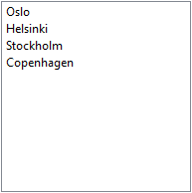

Common Widgets
Item Widgets
QListWidget is used to show lists of items
Adding items
  addItem(QString) – appends an item to the end of the list
  insertItem(int row, QString) – inserts an item at the specified row
Selection
  selectedItems – returns a list of QListWidgetItems used QListWidgetItem::text to determine the text
Signals
  itemSelectionChanged – emitted when the selection is changed
QComboBox shows a list with a single selection in a more compact format.
QListWidget
QComboBox
Notes:
There are three general types of item views in Qt: lists, tables and trees. For now, we'll stick to the lists.
Using a list widget, you have a list to which you can add and insert items
You can get a list of selected list widget items, and using the text property on those items, you can determine what is selected
You can listen to the itemSelectionChanged signal if you want to react to changes in selections
For a more compact dialog design, you can use a combo box to let the user pick one item from a list.
Continues

Slide 25

Common Widgets
Containers
Container widgets are used to structure the user interface
They can be considered passive (not entirely true)
A plain QWidget can be used as a container
Designer: Place widgets in the container and apply a layout to the container
Code: Create a layout for the container and add widgets to the layout
QGroupBox
QGroupBox *box = new QGroupBox();
QVBoxLayout *layout = new QVBoxLayout(box);
layout->addWidget(...);
...
QTabWidget
QFrame
Notes:
Container widgets are there to provide structure to the user interfaces – but also to group functionally (radio buttons)
For now, we can look at container widgets as purely passive players. That is, place and layout them.
When using Designer, the recommended approach is to populate the containers, then apply a layout to the containers.
When using code, create a layout with the container as parent, then add widgets to the layout.
Continues

Slide 26
Common Widgets
Input Widgets
Use QLineEdit for single line text entries
Signals:
  textChanged(QString) - emitted when the text is altered
  editingFinished() - emitted when the widget is left
  returnPressed() - emitted when return is pressed
Properties
  text – the text of the widget
  maxLength – limits the length of the input
  readOnly – can be set to true to prevent editing (still allows copying)
QLineEdit
Notes:
The input widgets are interesting, so we will spend some extra time on them. One of the most common is the line edit. It is a text editor for single line, plain text, entries
Signals: textChanged, but also editingFinished and at times returnPressed
Important properties: text, maxLength and readOnly
Remember, if you have a read only line edit, the user can still copy its contents, that is not possible with an ordinary label.
Continues

Slide 27
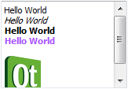
Common Widgets
Input Widgets
Use QTextEdit or QPlainTextEdit for multi line text entries
Signals
  textChanged() - emitted when the text is altered
Properties
  plainText – unformatted text
  html – HTML formatted text
  readOnly – can be set to prevent editing
QComboBox can be made editable through the editable property
Signals
  editTextChanged(QString) – emitted while the text is being edited
Properties
  currentText – the current text of the combo box
QTextEdit
QComboBox
Notes:
For more advanced text input (multi-line or formatted texts) you can use a text edit, or a plain text edit widget.
Signals: text changed
Properties: plainText (probably most interesting right now) and html (with formatting). These controls can also be made read only for showing documents, etc.
The combo box, shown in the list slide, can be made editable. Then the currentText property is of use.
Continues

Slide 28

Common Widgets
Input Widgets
There is a large choice of widgets for editing integer values
There are more for doubles, time and dates
Signals:
  valueChanged(int) - emitted when the value is updated
Properties
  value – the current value
  maximum – the maximum value
  minimum – the minimum value
QAbstractSlider
QSpinBox
QDial
QScrollBar
QSlider
Notes:
It can be tempting to use a line edit widget to get integer values from users, but it is better to use a widget aware of the task.
There are a set of slider widgets (inheriting abstract slider), but also the spin box that exposes the same signals and properties.
All these widgets have minimum, maximum and value properties along with a valueChanged signal.
There are (other) widgets for floating point values, dates and time.
Continues

Slide 29

Common Widgets
Display Widgets
The QLabel displays a text or a picture
Properties
  text – a text for the label
  pixmap – a picture to show
QLCDNumber is used to display integer values
Properties
  intValue – the value shown (set using display(int))
QLabel
QLabel
QLCDNumber
Notes:
The last group of widgets are the passive display widgets. This group contains what must be one of the most common widgets of all categories: the label.
A label widget can display an image, or a text. Use setText and setPixmap to assign a look to it.
A less common, but useful, widget is the LCD number. It reflects the integer input widgets well, and displays a value. Use the display function to set a value (this is because the widget can display doubles too, setIntValue is the obvious name).

Slide 30
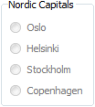
Common Widget Properties
All widgets have a set of common properties inherited from the QWidget base class
enabled – enable or disable user interaction
visible – shown or not (alter with show and hide)
These properties affect child widgets as
well. For instance, enable or disable a
container widget.
Notes:
As all widgets have a common base class, QWidget, they also share a set of properties.
The two most useful are enabled and visible.
Enabled, lets you enable or disable user interaction.
Visible lets you show and hide a widget (alter with the show/hide functions, or setVisible)
These properties also affect child widgets, so you can enable/disable or show/hide whole sections of a user interface. The example image shows a disabled group box with radio buttons. As the buttons are contained, they are automatically disabled.

Slide 31
Break
Notes:
Break here or before slide 31
Breaking here gives more time for the code in the first half.

Slide 32
Size Policies
Layout is a negotiation process between widgets and layouts
Layouts bring structure
  horizontal and vertical boxes
  grid
Widgets supply
  size policies for each direction
  minimum and maximum sizes
Notes:
Earlier it was stated that layouts and widgets negotiate for the screen estate.
Then we mentioned layouts and their role in the game – to provide a structure.
The widgets also bring something – size policies and size limitations
Continues

Slide 33
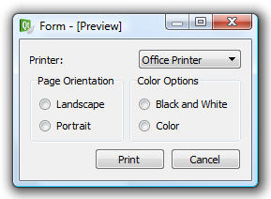
Size Policies
The example was not complete!
printerList->setSizePolicy(QSizePolicy::Expanding, QSizePolicy::Fixed)
Notes:
In the example dialog that we started this lecture with, we cheated. The top dialog is what the code did, but you where shown the bottom one.
What is the difference between the two? In the first case, the label and combo box are equally hungry for space, so they get an equal chunk.
By setting the horizontal size policy of the combo box to Expanding, we make it more hungry. This means that it gets as large as possible, pushing back the label to its smallest possible size.
Continues

Slide 34
Size Policies
Each widget has a size hint that is combined
with a policy for each direction
  Fixed – the hint specifies the size of the widget
  Minimum – the hint specifies the smallest possible size
  Maximum – the hint specifies the largest possible size
  Preferred – the hint specifies preferred, but not required
  Expanding – as preferred, but wants to grow
  MinimumExpanding – as minimum, but wants to grow
  Ignored – the size hint is ignored, widget gets as much space as possible
Notes:
Which size policies are available? All widgets provide a size hint based on their contents. From this hint, the following policies are available
Remember that policies are set for each direction (vertical and horizontal) so a widget can be expanding horizontally while being fixed vertically
Fixed, Minimum, Maximum, Preferred, Expanding, MinimumExpanding, Ignored
But how are these policies read? Continues

Slide 35
Size Policies
Each widget has a size hint that is combined
with a policy for each direction
  Fixed – fixed to size hint
  Minimum – can grow
  Maximum – can shrink
  Preferred – can grow, can shrink
  Expanding – can grow, can shrink, wants to grow
  MinimumExpanding – can grow, wants to grow
  Ignored – the size hint is ignored, can grow, can shrink
Notes:
The most strict policy is fixed. It will use the size hint for size.
Minimum, Maximum, Preferred can grow
Expanding and MinimumExpanding can and want to grow
This means that expanding widgets are more likely to grow, but preferred can.
What happens when combining these? Continues

Slide 36




What If?
Two preferred next to each other
One preferred, one expanding
Two expanding next to each other
Not enough widget to fill the space (fixed)
Notes:
Widgets that can and/or want to grow equally much get an equal amount of space
Widgets that want to grow next to widgets that only can grow get as much space as possible
When a widget is limited in size and cannot fill its assigned area it is centered (can happen to Fixed and Maximum policies)
Continues

Slide 37
More on Sizes
Widget sizes can be further controlled using the properties for maximum and minimum size
maximumSize – largest possible size
minimumSize – smallest possible size
ui->pushButton->setMinimumSize(100, 150);
ui->pushButton->setMaximumHeight(250);
Notes:
The last ingredient in the size negotiation is the widget's size restrictions.
You can set minimum and maximum size for all widgets.
You can even limit one single direction, i.e. setMaximumHeight or setMinimumWidth.

Slide 38
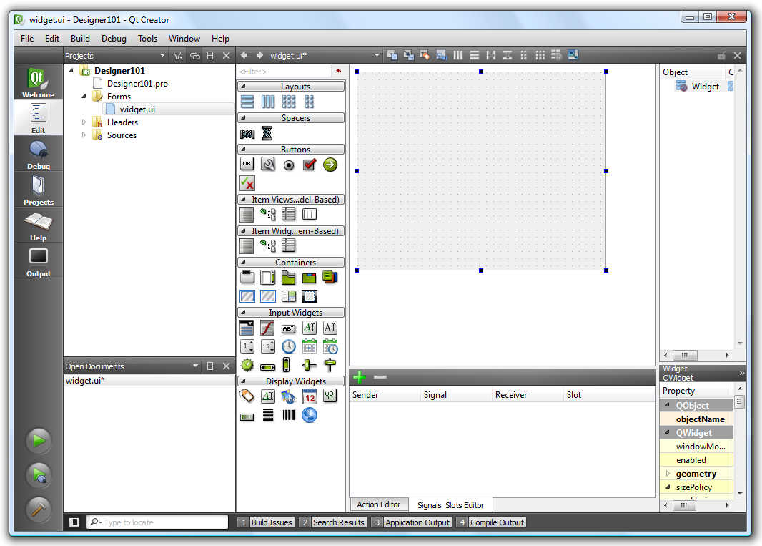
Introducing Designer
Designer was historically a separate tool, but is now part of Qt Creator
A visual editor for forms
Drag-and-drop widgets
Arrange layouts
Make connections
Notes:
Designer is one of the tools that has been shipped with Qt since forever. These days it is an integrated part of Qt Creator, but if you start a command prompt and type designer, it will start.
It is a tool for editing the user interfaces. You can drag and drop widgets, work with layouts and also make signal/slot connections.
Continues

Slide 39
Introducing Designer
sources
*.cpp
compiles
object files
*.o
links
executables
includes
compiles
headers
*.h
mocs
generated
moc_*.cpp
user interfaces
*.ui
Notes:
User interfaces, forms, are stored as *.ui files. These are XML files describing the interfaces.
Continues

Slide 40
Introducing Designer
sources
*.cpp
compiles
object files
*.o
links
executables
includes
compiles
headers
*.h
mocs
generated
moc_*.cpp
user interfaces
*.ui
uics
generated
ui_*.h
Notes:
The ui files are compiled into C++ using the user interface compiler, uic. The resulting files are included into either the source or header files.
Continues

Slide 41
Using the Code
#ifndef WIDGET_H
#define WIDGET_H
#include <QWidget>
namespace Ui {
class Widget;
}
class Widget : public QWidget {
Q_OBJECT
public:
Widget(QWidget *parent = 0);
~Widget();
private:
Ui::Widget *ui;
};
#endif // WIDGET_H
Forward declaration
of the Ui::Widget class
Basically a standard QWidget derived class
A Ui::Widget pointer,
ui, refers to all widgets
Notes:
Looking at the code generated by Qt Creator when creating a designer form class.
The header file.
The class is called Widget, so the result from designer will be Ui::Widget. Here it is forward declared, so the header will be included in the cpp file.
The Widget class defines a basic QWidget-derived class, but includes a Ui::Widget pointer called ui.
The naming is not necessary, but it is convention to use it.
Continues

Slide 42
Using the Code
#include "widget.h"
#include "ui_widget.h"
Widget::Widget(QWidget *parent) :
QWidget(parent),
ui(new Ui::Widget)
{
ui->setupUi(this);
}
Widget::~Widget()
{
delete ui;
}
Instanciates the
Ui::Widget class
as ui
Calls setupUi, creating all the widgets as children to the given parent (this).
Deletes the ui
object
Notes:
The cpp file implements a constructor and destructor that initializes ui with a new instance of Ui::Widget and deletes it when the Widget instance is destructed.
The constructor calls ui->setupUi(this), this creates the widgets (object instances) as defined in Designer with the this object as the overall parent.

Slide 43
Using Designer
Basic working order
  Place widgets roughly
  Apply layouts from the inside out, add spacers as needed
  Make connections
  Use from code
  Throughout the process, alter and edit properties
Practice makes perfect!
Notes:
Developing software is an iterative process, so you are likely to revise what I say now.
The basic working process when using designer can be divided into four steps.
First, place all widgets.
Second, apply layouts from the inside out, i.e. start with the widgets contained in other widgets and work your way to the top level widget. One could say, layout the leaves of the object tree.
Third, make any connections that you want to have (this can really be done at any time)
Fourth, write the code for the user interface.
Throughout this process, you can alter and edit properties.
Remember that using designer needs practice.
Continues

Slide 44
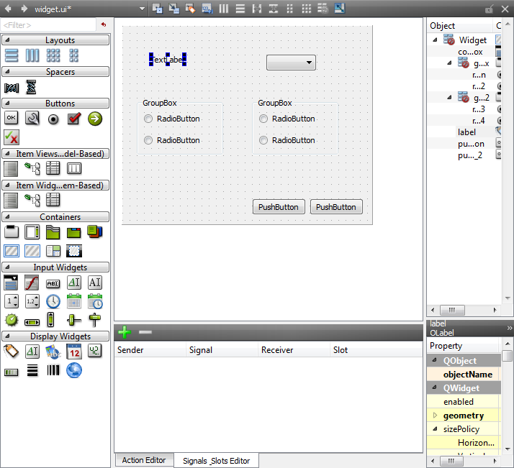
Using Designer
Place widgets roughly
drag-and-drop
Notes:
Looking at the process (you can demonstrate this if you like, the target is the example dialog that we started with)
First place the widgets roughly as you want them. Drag them from the widget list to the form.
Continues

Slide 45
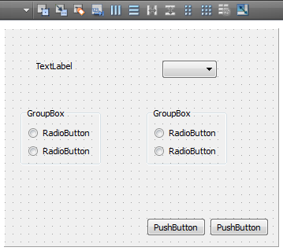
Using Designer
Apply layouts from the inside out, add spacers as needed
2
1
1. Select each group box, 2. apply a vertical box layout
Notes:
Next start applying layouts. The inner-most widgets are the check boxes in the group boxes.
Select each group box and apply a vertical box layout.
Continues

Slide 46
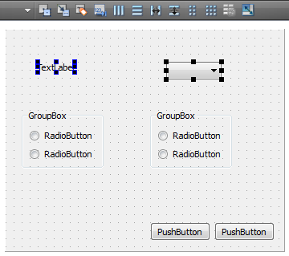
Using Designer
Apply layouts from the inside out, add spacers as needed
1
2
1. Select the label (click), 2. Select the combobox (Ctrl+click)
Notes:
The next level of layouts will be each row of the main dialog.
Select the widgets on each row (label + combo) using clicks and ctrl+click.
Continues

Slide 47
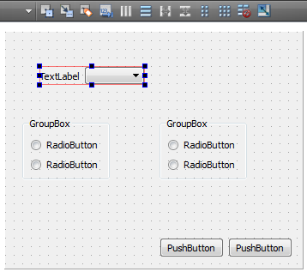
Using Designer
Apply layouts from the inside out, add spacers as needed
1
1. Apply a horizontal box layout
Notes:
When a full row has been selected, apply a horizontal box layout to them.
Continues

Slide 48
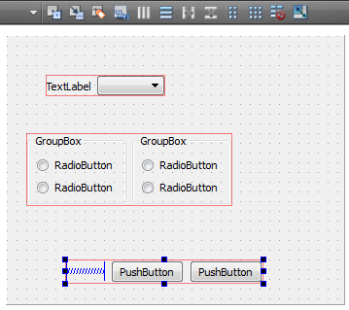
Using Designer
Apply layouts from the inside out, add spacers as needed
1
3
2
1. Select both group boxes and lay them out, 2. add a horizontal spacer,
3. place the buttons and spacer in a layout
Notes:
Do this for the two group boxes as well
For the buttons, we need a spacer to keep them to the right. (The ideal choice would have been to use a dialog button box here, but we will do that in the exercises.)
Add the spacer, select it and the two buttons and lay them out
Continues

Slide 49
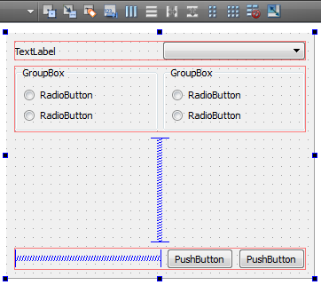
Using Designer
Apply layouts from the inside out, add spacers as needed
3
2
1
1. Add a vertical spacer, 2. select the form itself, 3. apply a vertical box layout
Notes:
The final step is to add the spacer between the group boxes and buttons (to determine where the dialog is to grow – the alternative would have been stretching group boxes, but that looks bad)
Add the spacer, select the form itself, apply a vertical layout.
If demonstrating, preview using Ctrl+Alt+R (from
Qt Creator).
Continues

Slide 50
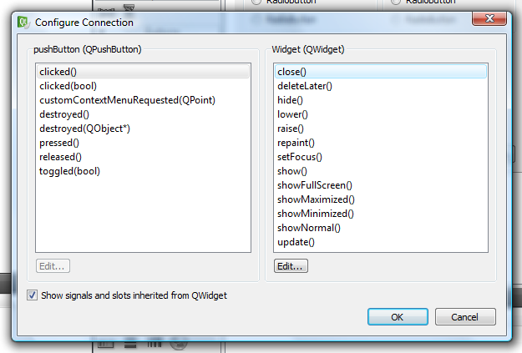
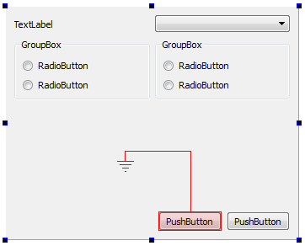
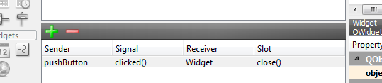
Using Designer
Make connections (between widgets)
1
3
2
4
1. Switch to signals and slot editing mode, 2. drag from one widget to another,
3. pick the signal and slot, 4. see the result in the connections' dock
Notes:
There are two ways to make connections. Either between widgets on the form or between widgets and your code.
When connecting widgets on the form, switch to signal and slot editing mode (toolbar).
Then drag from the source to the destination.
Pick a signal and a slot (the form is a QWidget, so the “include signals and slots inherited from QWidget” check box must be checked)
When a connection has been made you can see it in the connections dock
Continues

Slide 51
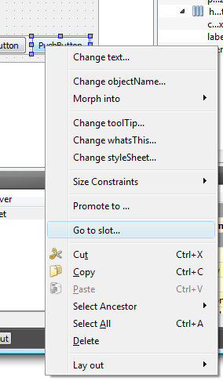
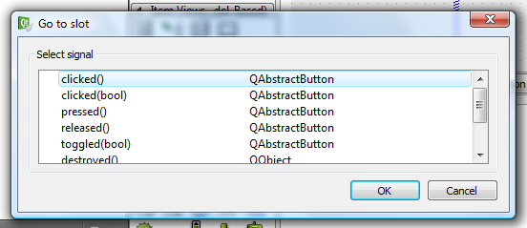
Using Designer
Make connections (to your code)
1
3
2
1. Use the widget editing mode, 2. right click on a widget and pick Go to slot...
3. pick the signal to connect to your code
Notes:
To make connections from a widget to your code, you need to be in the widget editing mode (toolbar)
Right click on a widget, pick go to slot and pick a signal to react to. This takes you to the corresponding code.
Continues

Slide 52
Using Designer
Use from code
Access all widgets through the ui class member
class Widget : public QWidget {
...
private:
Ui::Widget *ui;
};
void Widget::memberFunction()
{
ui->pushButton->setText(...);
}
Notes:
Finally, you need to write the code for the user interface.
You can access all widgets of the user interface through the ui class member.
All pointers are valid after having called setupUi.

Slide 53
Top-level Windows
Widgets without a parent widget automatically become windows
  QWidget – a plain window, usually non-modal
  QDialog – a dialog, usually expecting a result such as OK, Cancel, etc
  QMainWindow – an application window with menus, toolbars, statusbar, etc
QDialog and QMainWindow inherit QWidget

Slide 54
Using QWidget as Window
Any widget can be a window
Widgets without a parent are automatically windows
Widgets with a parent have to pass the Qt::Window flag to the QWidget constructor
Use setWindowModality to make modal
  NonModal – all windows can be used at once
  WindowModal – the parent window is blocked
  ApplicationModal – all other windows are blocked
Notes:
WindowModal, affects parents, grand parents, and so on

Slide 55
Window Properties
Set the window title using setWindowTitle
The QWidget constructor and window flags
QWidget::QWidget(QWidget *parent, Qt::WindowFlags f=0)
  Qt::Window – creates a window
  Qt::CustomizeWindowHint – clear defaults
    Qt::WindowMinimizeButtonHint
    Qt::WindowMaximizeButtonHint
    Qt::WindowCloseButtonHint
    etc
The word hint is important
Different platforms and
window managers affect
the effect of these settings

Slide 56
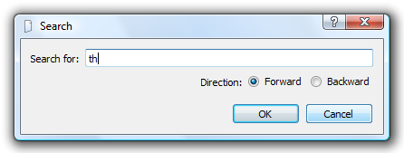
Using QDialog
A search dialog is a typical custom dialog
Inherited from QDialog
User interface created using Designer or code
  QLabel and QRadioButton are “outputs”
  Buttons for accepting or rejecting

Slide 57
The Programming Interface
Initialize the dialog
in the constructor
class SearchDialog : public QDialog
{
Q_OBJECT
public:
explicit SearchDialog(const QString &initialText,
bool isBackward, QWidget *parent = 0);
bool isBackward() const;
const QString &searchText() const;
private:
Ui::SearchDialog *ui;
};
Getter functions for
clean access of data

Slide 58
The Implementation
SearchDialog::SearchDialog(const QString &initialText,
bool isBackward, QWidget *parent) :
QDialog(parent), ui(new Ui::SearchDialog)
{
ui->setupUi(this);
ui->searchText->setText(initialText);
if(isBackward)
ui->directionBackward->setChecked(true);
else
ui->directionForward->setChecked(true);
}
bool SearchDialog::isBackward() const
{
return ui->directionBackward->isChecked();
}
const QString &SearchDialog::searchText() const
{
return ui->searchText->text();
}
Initialize dialog according
to settings
Getter functions

Slide 59
Using the Dialog
The software interface has been defined to make it easy to use the dialog
void MyWindow::myFunction()
{
SearchDialog dlg(settings.value("searchText","").toString(),
settings.value("searchBackward", false).toBool(), this);
if(dlg.exec() == QDialog::Accepted)
{
QString text = dlg.searchText());
bool backwards = dlg.isBackward());
...
}
}
QDialog::exec shows
a modal (blocking)
dialog and returns the
result as accepted or
rejected

Slide 60
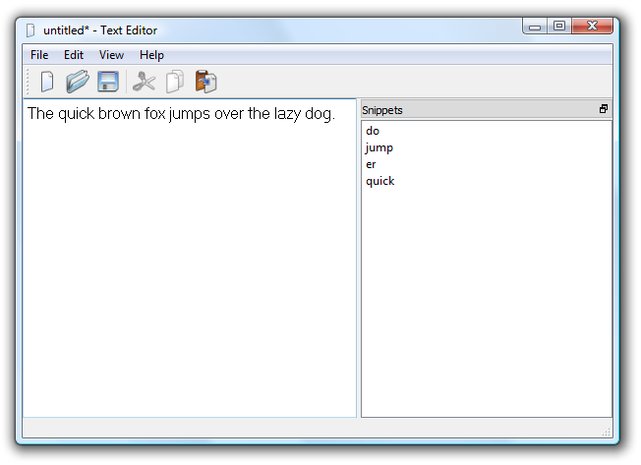
Using QMainWindow
A QMainWindow is the document window of the average desktop application
  Menus
  Toolbar
  Statusbar
  Docks
  Central widget
Notes:
Point out and name the different parts of the window

Slide 61
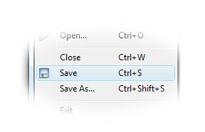
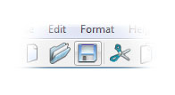
Introducing QAction
Many user interface elements refer to the same user action
A QAction object can represent all these access ways – and hold tool tips, statusbar hints, etc too
Action
Ctrl+S

Slide 62
Introducing QAction
A QAction encapsulates all settings needed for menus, tool bars and keyboard shortcuts
Commonly used properties are
  text – the text used everywhere
  icon – icon to be used everywhere
  shortcut – shortcut
  checkable/checked – whether the action is checkable and the current check status
  toolTip/statusTip – tips text for tool tips (hover and wait) and status bar tips (hover, no wait)

Slide 63
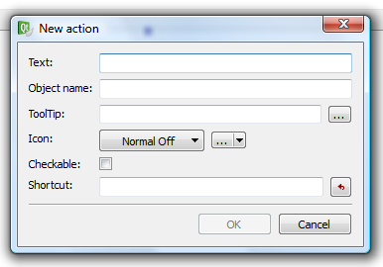
Introducing QAction
Creating a new action
QAction *action = new QAction(parent);
action->setText("text");
action->setIcon(QIcon(":/icons/icon.png"));
action->setShortcut(QKeySequence("Ctrl+G"));
action->setData(myDataQVariant);
Setting properties
for text, icon and
keyboard short-cut
A QVariant can be
associated with each
action, to carry data
associated with the
given operation
Or use the editor
in Designer

Slide 64
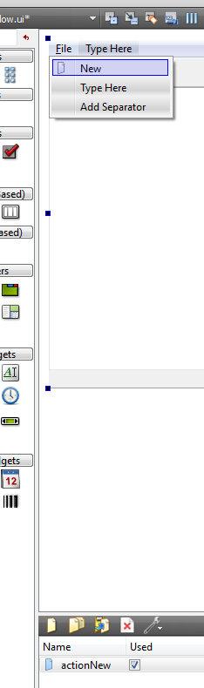
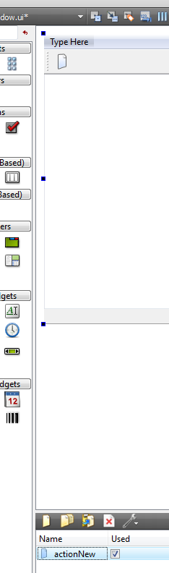
Adding actions
Adding actions to different parts of the user interface is as easy as calling add Action
In Designer, simply drag and drop
each action into place on a
tool bar or menu
myMenu->addAction(action);
myToolBar->addAction(action);

Slide 65
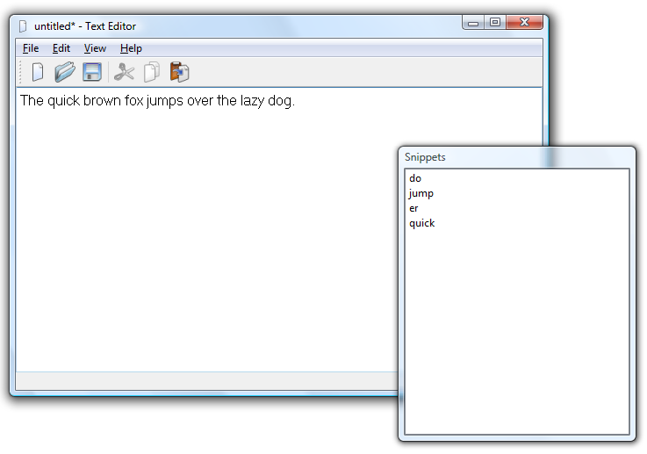
Dock widgets
Dock widgets are detachable
widgets placed around the edges of a QMainWindow
  Great for multi-head setups
Simply place your widget inside a QDockWidget
QMainWindow::addDockWidget adds the docks to the window

Slide 66
Dock widgets
A new dock with
a title
void MainWindow::createDock()
{
QDockWidget *dock = new QDockWidget("Dock", this);
dock->setFeatures(QDockWidget::DockWidgetMovable |
QDockWidget::DockWidgetFloatable);
dock->setAllowedAreas(Qt::LeftDockWidgetArea |
Qt::RightDockWidgetArea);
dock->setWidget(actualWidget);
...
addDockWidget(Qt::RightDockWidgetArea, dock);
}
Can be moved
and floated
(not closed!)
The actual
widget is what
the user
interacts with
Can be docked
along the sides
Finally, add it to the window

Slide 67
Icon resources
Putting icons in a resource file lets Qt embed them into the executable
  Avoid having to deploy multiple files
  No need to try to determine the path for the icons for each specific install type
  All fits neatly into the build system
  ...
  You can add anything into resources, not only icons

Slide 68
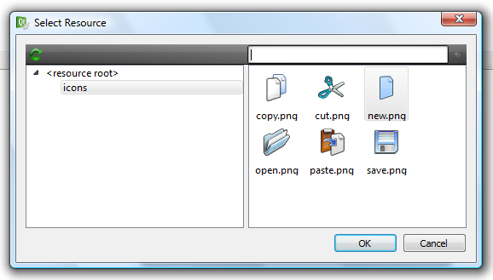
Icon resources
You can easily manage resource files in Qt Creator
Prefix path and filenames with : to use a resource
Or simply pick an icon from the list in Designer
QPixmap pm(":/images/logo.png");

Slide 69

Style sheets
For highlighting and cross platform styling, all QWidget classes have a styleSheet property
Style sheets are inspired from CSS
They can be used for highlighting and for various small alternations
As well as a total overhaul of the entire user interface
Notes:
Standard user interfaces can be kind of boring. Sometimes one wants to add some color, sometimes it is desirable to highlight a part of the user interface.
For this, Qt comes with style sheet support. These are inspired by the web's cascading style sheets (css).
They can be used to alter most of the user interface to your liking.
Continues

Slide 70
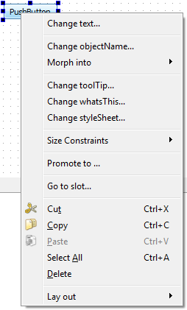
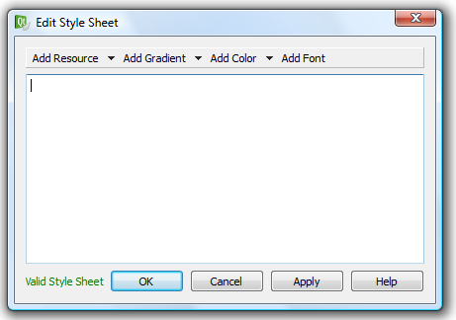
Style sheets
The easiest way to apply a style sheet to an individual widget is to use Designer
Notes:
The easiest way to add style to a specific widget is to right click on it in Designer. This takes to you Designer's style editor where you can use the drop down menus to create new style definitions.
Continues

Slide 71
Stylesheet
To style an entire application, use QApplication::setStyleSheet
Select a class
QLineEdit { background-color: yellow }
QLineEdit#nameEdit { background-color: yellow }
QTextEdit, QListView {
background-color: white;
background-image: url(draft.png);
background-attachment: scroll;
}
QGroupBox {
background-color: qlineargradient(x1: 0, y1: 0, x2: 0, y2: 1,
stop: 0 #E0E0E0, stop: 1 #FFFFFF);
border: 2px solid gray;
border-radius: 5px;
margin-top: 1ex;
}
Select an
object by name
Use images
Build these in
Designer's editor
Notes:
If you want to style more than a single widget or form you can apply a style sheet to the entire application.
This cannot be read unless you are vaguely familiar with the css concept.
Use selectors to pick classes, or specific objects
Alter properties such as borders, backgrounds, fonts, margins, etc.
You can use gradients and images. Using Designer you can graphically design gradients and cut and paste them into the application style sheet later.

